Slide 1
mathematics of rough paths action recognition and health
Terry Lyons
Mathematical Institute, Oxford
Alan Turing Institute
EPSRC EP/S026347/1
Hao Ni, Thomas Cass, Wiexin Yang, Danyu Yang, Imanol Perez, Paul More, Jiawei Yang, James Morrill, Patrick Kidger, James Foster,
Cris Salvi, Patrick Bonnier,….
Action recognition: Weixin Yang, Kevin Schlegel, Hao Ni, Cordelia Schmid, Lianwen Jin

Slide 2
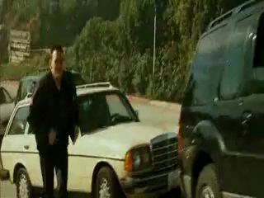
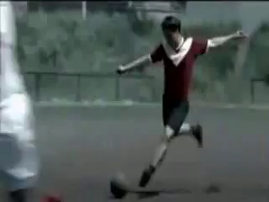
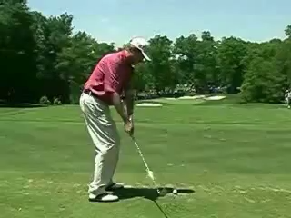
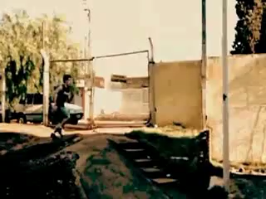
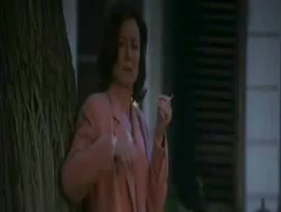
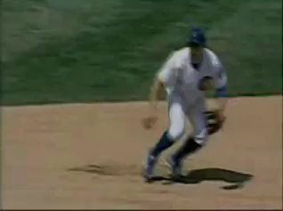
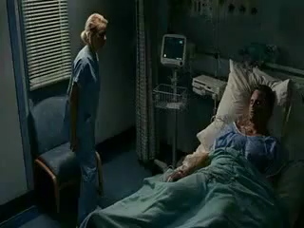
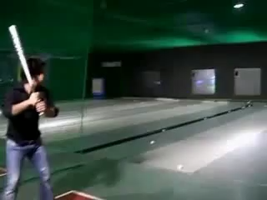
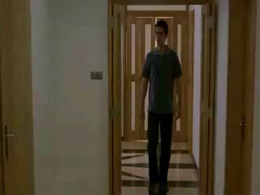
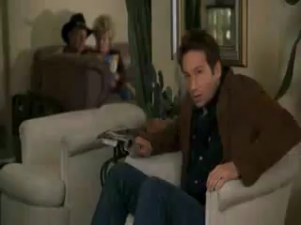
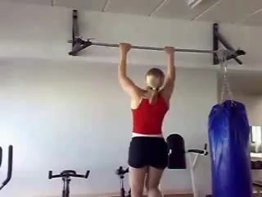
Human Activity in Video
Jhuang, H., Gall, J., Zuffi, S., Schmid, C. and Black, M.J., 2013. Towards understanding action recognition. In Proceedings of the IEEE international conference on computer vision (pp. 3192-3199).

Slide 3
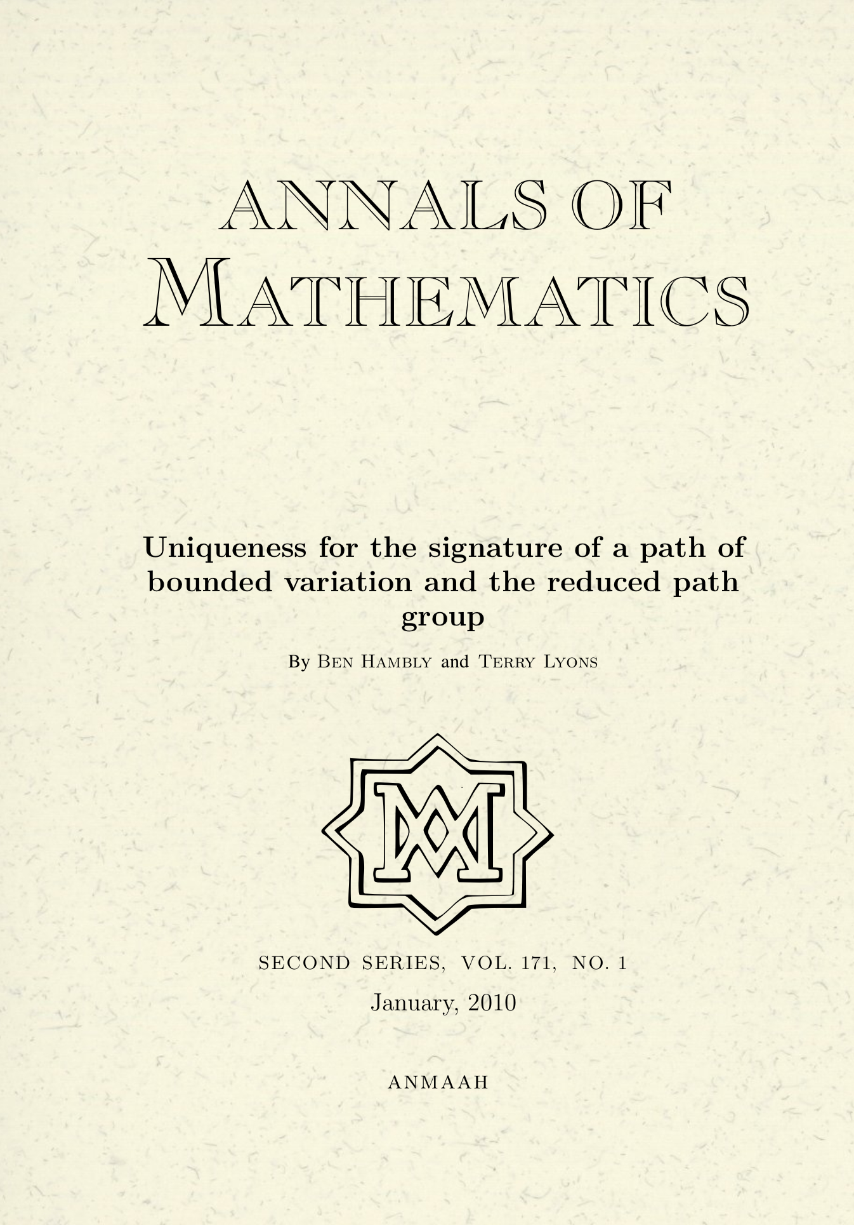
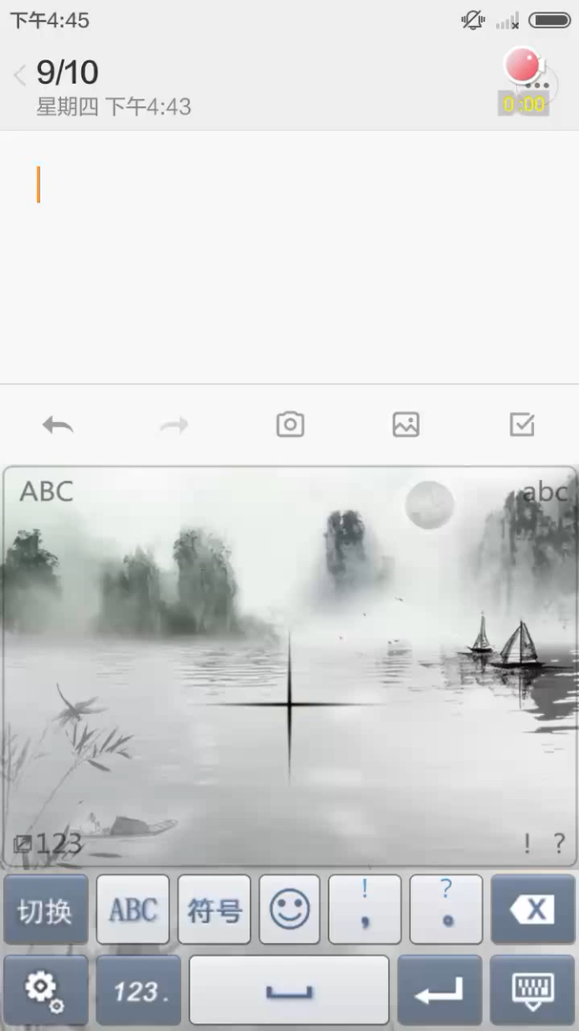
Technology underlying research
Main Technology :
A new area of mathematics known as Rough Path Theory, and a mathematical tool known as the ‘path signature’ provide a way of adding value to conventional machine learning to better ‘understand’ evolving data streams.
The goal is to develop a powerful mathematical framework for the systematic understanding of patterns in evolving multimodal data and for the classification of these patterns; and build tools for PyTorch, TensorFlow etc. to better learn from multimodal streams.
A significant example early application of this approach was to the online Chinese handwriting problem. Ben Graham won the ICDAR competition. SCUT (Lianwen Jin) then engineered an app that works well on CASIO, ICDAR and real world contexts. Absorbed into Sogou.
Notes:
Explain what path signatures are (glossary says patterns in video data)
Include in talk over of slide why its cutting edge, difficult, not yet solved, why do the research now – e.g.reference to Rough Path Theory and the fact its new/cutting edge

Slide 4
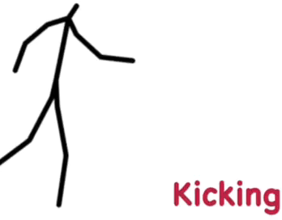
Technology underlying research
Our primary focus today:
We will look at core mathematical reasons why the path signature brings something new. We will also introduce applications:
One of those applications is to create generic methodology that can classify the changing state of a system with modest samples and training; e.g. the movement of an individual using only de-identified “landmark data”. The approach is robust enough to accept input from automated pose identification software such as alpha-pose and open-pose with reasonable success.
Our mathematical technology enables reasonable recognition of human actions from video data without using personally identifiable data. Moreover the method does not use deep learning and provides interpretable output (although it can be used with it).
Notes:
Explain what path signatures are (glossary says patterns in video data)
Include in talk over of slide why its cutting edge, difficult, not yet solved, why do the research now – e.g.reference to Rough Path Theory and the fact its new/cutting edge

Slide 5
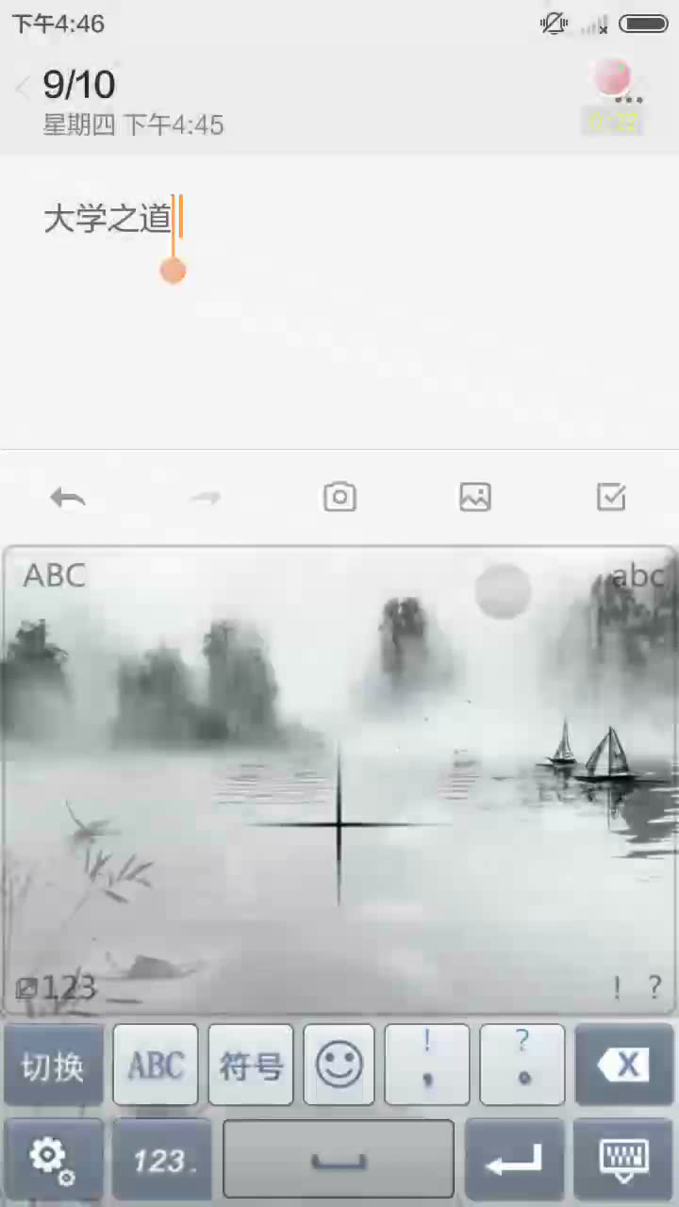
Rough paths - streamed data
      a finger drawn character on the Mate or iPhone
      a financial order book
      a piece of text
      a patient record at a hospital
      astronomical data
      an evolving stream of emotions
Notes:
Not stationary
Not large sample
Many challenges
Identify fraudulent transactions
Link outcomes to patterns of medication and wellbeing
Capture transient events
Better understand and help people in pain with mental illness

Slide 6
Rough paths - streamed data
  Period of rapid change
    in our understanding and modelling of data
    in the role of optimisation
    In how we use information
  A data scientist might ask what is left for mathematics to say?
  The mathematics of information has also been changing!
    In this presentation explain how the mathematics of rough path theory adds new perspectives
    We will focus on two (there are several more):
      removing an infinite dimensional invariance (gauge invariance)
      capturing data more robustly (continuity of control)
    New feature set enhances existing data science techniques

Slide 7
Mathematics - Not magic
Rough path theory
    toolset for working with highly oscillatory evolving systems
    Now used to describe
    multimodal streams
      concise and mathematically well posed (no arbitrariness)
      captures the order in which things happen

Slide 8
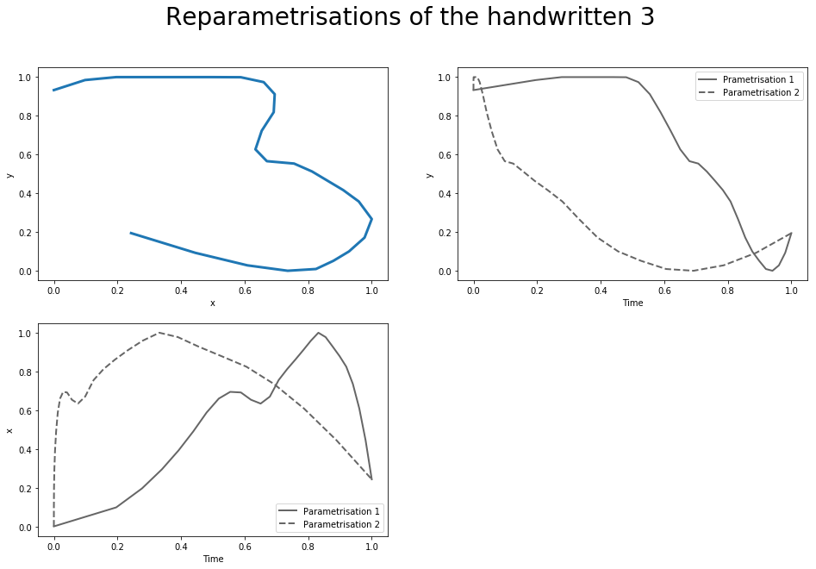
Rough paths: streamed data
      The letter “3” is drawn from top to bottom
Notes:
27secs on

Slide 9
Rough paths: streamed data
      The letter “3” is drawn from top to bottom
      The x coordinate of the evolving symbol plotted against time at different speeds
      This is the classic ML approach. But it is very unstable.
Notes:
27secs on

Slide 10
Rough paths: streamed data
      The number “3” x, y coordinates – same picture drawn at two different speeds
      No consistent wavelets
      Reparameterizations do not form a linear space!
Notes:
27secs on

Slide 11
Rough paths: streamed data
      The letter “3” is drawn from top to bottom
      How does one describe the three or any path modulo the symmetry of parametrisation?
Notes:
27secs on

Slide 12

Rough paths: streamed data
      How do we describe this unparameterized path mathematically?
      Describe this multidimensional path in terms of its effects on certain nonlinear systems
      Describe $γ$ using the first few terms in solution of $dS=S⊗dγ$.
Notes:
27secs on

Slide 13
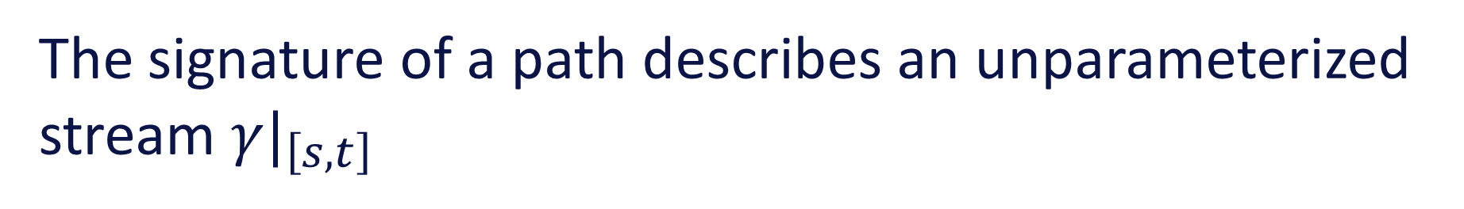
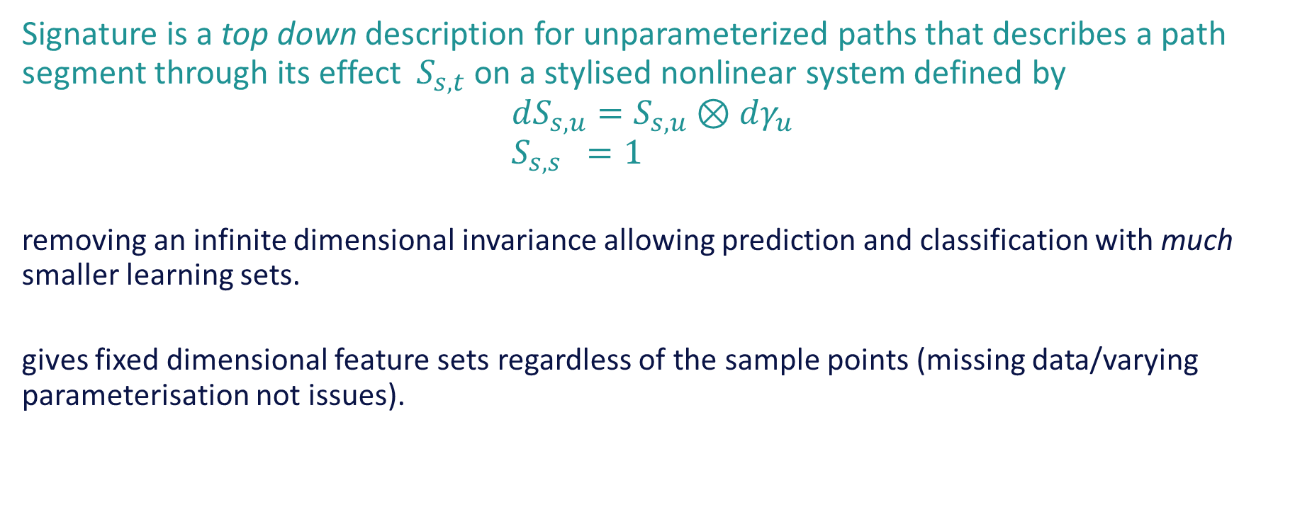
The signature of a path describes an unparameterized stream ${γ|}_{\left[s,t\right]}$
Signature is a top down description for unparameterized paths that describes a path segment through its effect $S_{s,t}$ on a stylised nonlinear system defined by
$$dS_{s,u}=S_{s,u}⊗dγ_{u} \\ S_{s,s} =1$$
  removing an infinite dimensional invariance allowing prediction and classification with much smaller learning sets.
  gives fixed dimensional feature sets regardless of the sample points (missing data/varying parameterisation not issues).

Slide 14
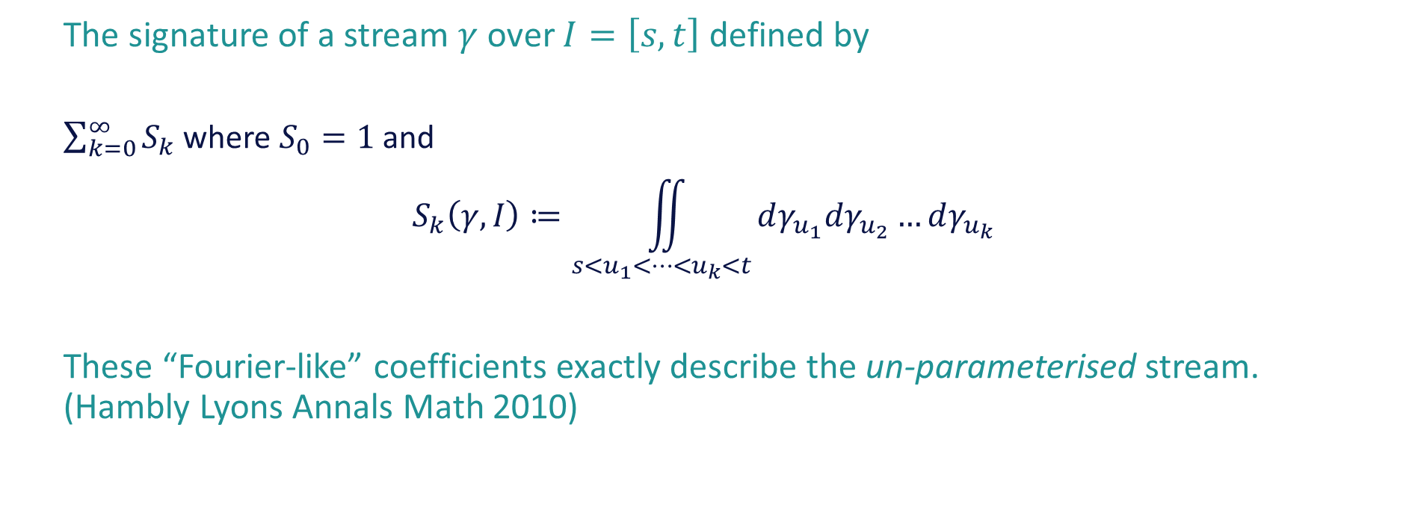
The signature – faithful and universal features describing an unparameterised stream
The signature of a stream $γ$over $I=\left[s,t\right]$ defined by
  $\sum_{k=0}^{∞}{S_{k}}$ where $S_{0}=1$ and
  $$S_{k}\left(γ,I\right)≔\iint_{s<u_{1}<…<u_{k}<t}{dγ_{u_{1}}dγ_{u_{2}}…dγ_{u_{k}}}$$
These “Fourier-like” coefficients exactly describe the un-parameterised stream. (Hambly Lyons Annals Math 2010)

Slide 15
The signature – faithful and universal features describing an unparameterized stream
Fundamental tool in Rough path theory; foundational mathematics redefining how one talks about paths; extends calculus of Newton and Ito to broad new ranges of complex interacting systems. An under-pinning contribution to Fields medal winning mathematical work of Hairer.
Crucially for data applications, it removes parametrisation and can reduce the dimensionality of streamed data quite dramatically.
There is a world wide (PyPy) availability of a Python package “esig”.

Slide 16
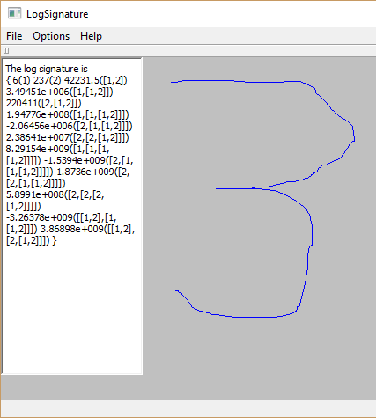
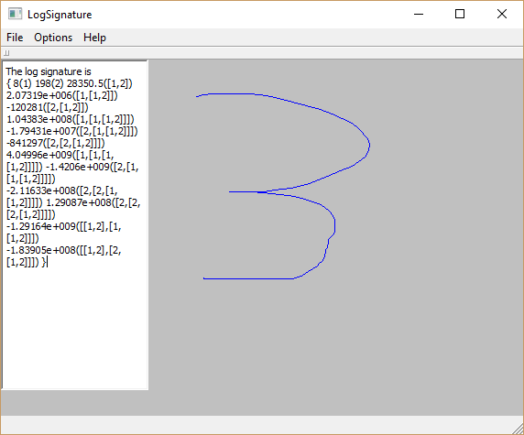

Slide 17
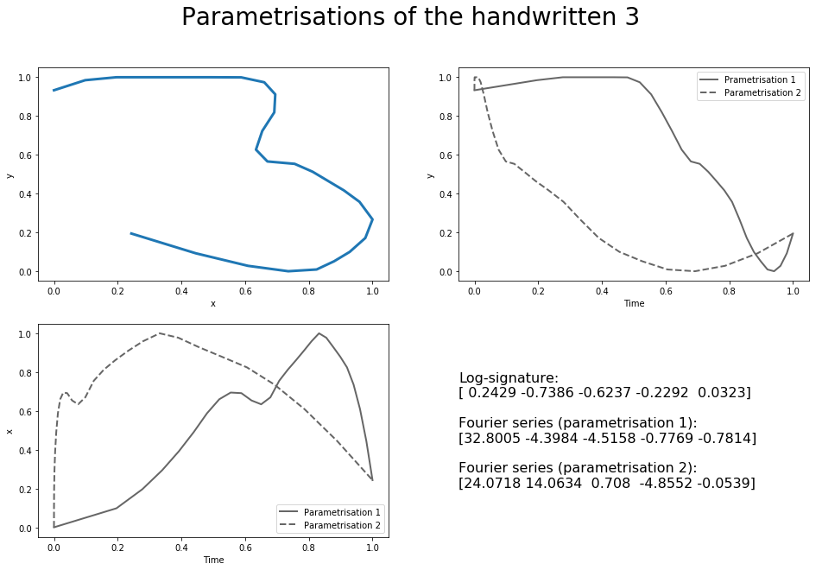
Rough paths: streamed data
      Fourier Series
      Intrinsically unstable
        Cameron Clark
        Dickinson
      n-dimensional linear summaries predict effects O(1/n^1/2)
      signatures O(1/(n/2)!)
Notes:
27secs on

Slide 18
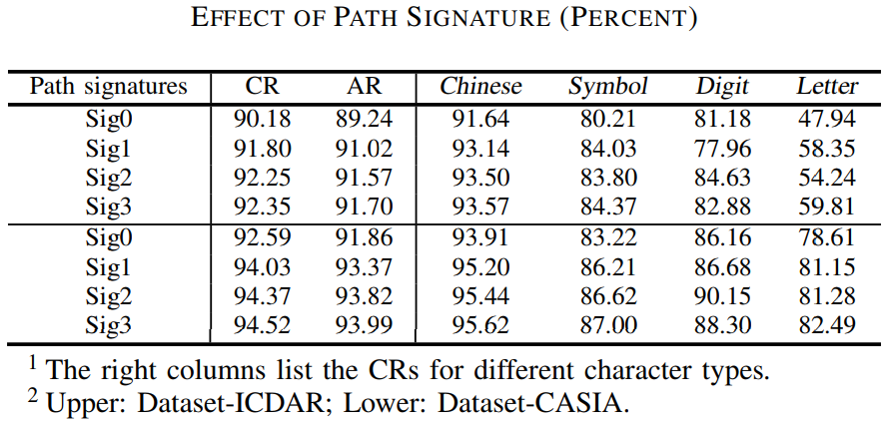
Handwriting Textline Recognition
Z. Xie, Z. Sun, L. Jin, H. Ni, and T. Lyons, “Learning spatial-semantic context with fully convolutional recurrent network for online handwritten Chinese text recognition,” IEEE transactions on pattern analysis and machine intelligence (IEEE TPAMI), 2017.
Notes:
Using path signatures made a difference

Slide 19
SCUT gPen, Sogou IME
      https://itunes.apple.com/cn/app/scut-gpen-shou-xie-shu-ru-fa/id957809824?l=en&mt=8
      Sogou IME, https://itunes.apple.com/cn/app/id917670924
      https://play.google.com/store/apps/details?id=net.hciilab.scutgPen.IME&hl=en 1-5 million downloads
      Sogou IME: https://play.google.com/store/apps/details?id=com.sohu.inputmethod.sogou 10-50 million downloads
Notes:
The work of Ben Graham, and then SCUT lead to viable engineering outcomes

Slide 20
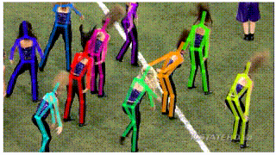
Rough paths: streamed data
Many types of stream
Reducing video to landmarks and pose is now feasible!
The matchstick men and women are data streams in 30-75 dimensions
  Still need to make sense of the data!
  Starting times shift
  Speed varies
http://mvig.sjtu.edu.cn/research/alphapose.html
Notes:
27secs on

Slide 21
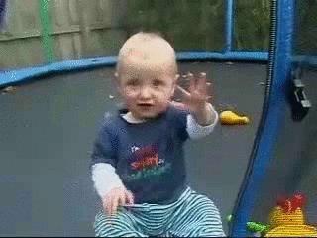
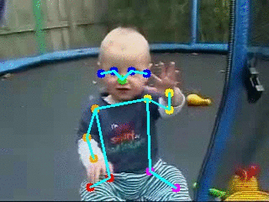
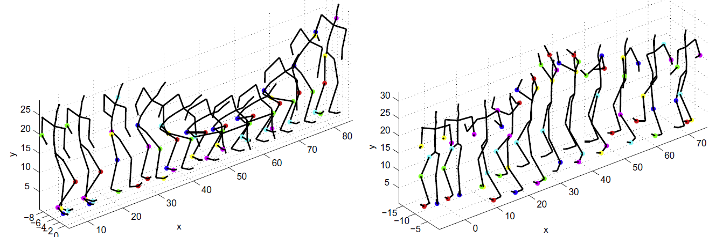
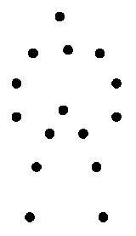
Action recognition
To assign action label to video clip
Pose Estimation
Action Recognition from RGB data
“Clapping”
Action Recognition from landmark data

Slide 22
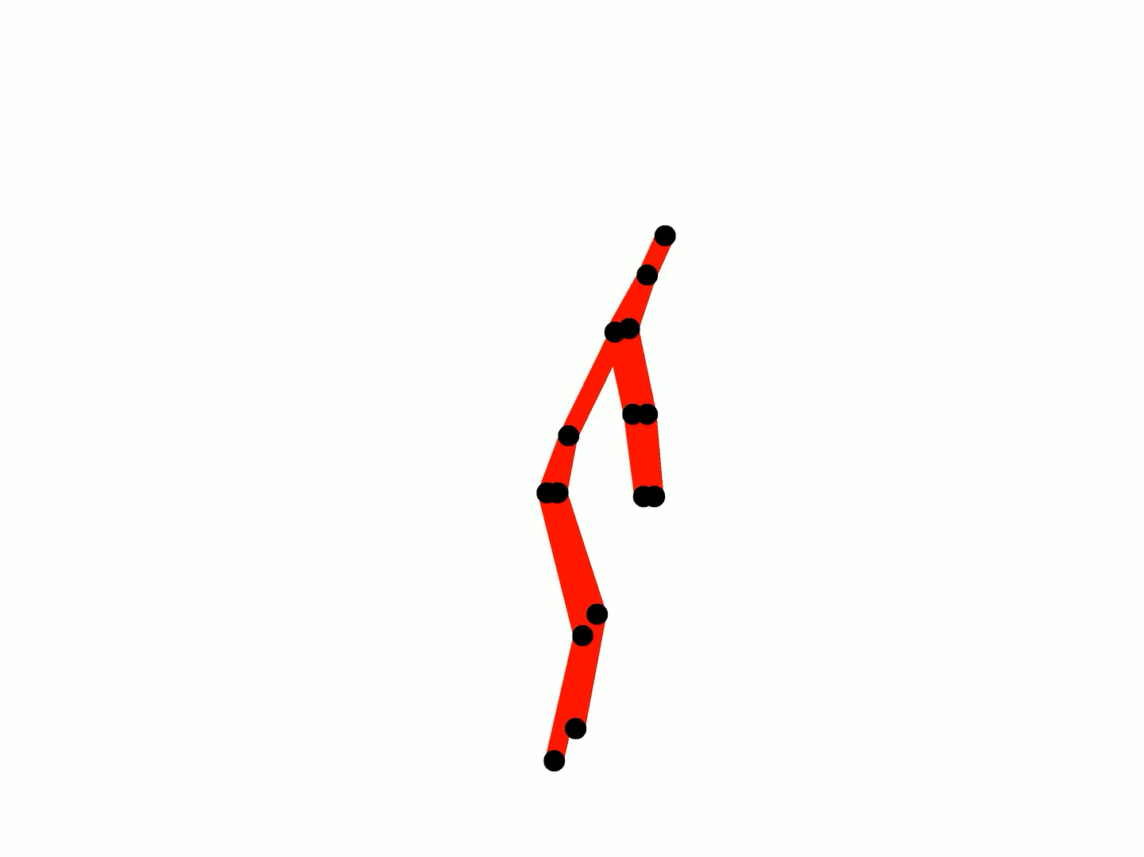

Slide 23
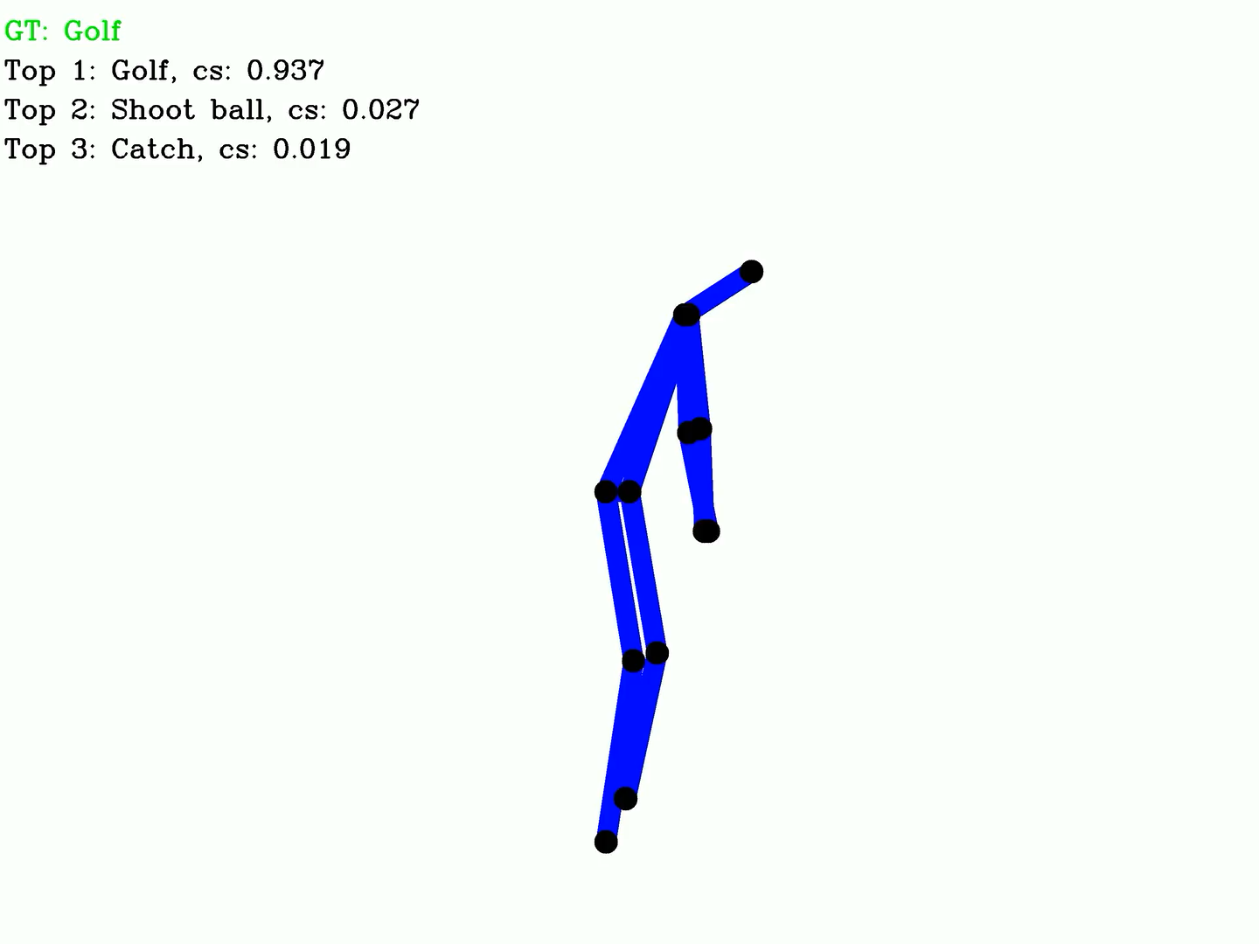
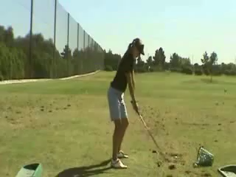
GOLF

Slide 24
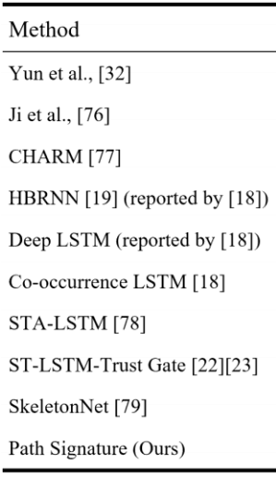
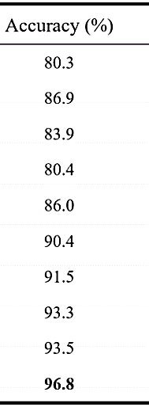
Experimental results
SBU Interaction Dataset (Kinect 3D)
#classes: 21
#samples: 300
Privacy
[32] K. Yun, et al. “Two-person interaction detection using body-pose features and multiple instance learning,” CVPRW, pp. 28-35, 2012.
[76] Y. Ji, et al. “Interactive body part contrast mining for human interaction recognition,” In ICMEW, pp. 1-6, 2014.
[77] W. Li, et al. “Category-blind human action recognition: a practical recognition system,” In ICCV, pp. 4444-4452, 2015.
[18] W. Zhu, et al. “Co-occurrence feature learning for skeleton based action recognition using regularized deep LSTM networks,” In AAAI, vol. 2, 2016.
[19] Y. Du, et al. “Hierarchical recurrent neural network for skeleton based action recognition,” In CVPR, pp. 1110-1118, 2015.
[78] S. Song, et al. “An end-to-end spatio-temporal attention model for human action recognition from skeleton data,” In AAAI, vol. 1, no. 2, p. 7, 2017.
[23] J. Liu, et al. “Skeleton-based action recognition using spatio-temporal lstm network with trust gates,” IEEE TPAMI, 2017.
[79] Q. Ke, et al. “SkeletonNet: mining deep part features for 3-D action recognition,” IEEE Signal Processing Letters, vol. 24, no. 6, pp. 731-735, 2017.
[Ours] W. Yang, T. Lyons, H. Ni, C. Schmid, L. Jin, “Leveraging the Path Signature for Skeleton-based Human Action Recognition,” arXiv preprint arXiv:1707.03993, 2017.

Slide 25
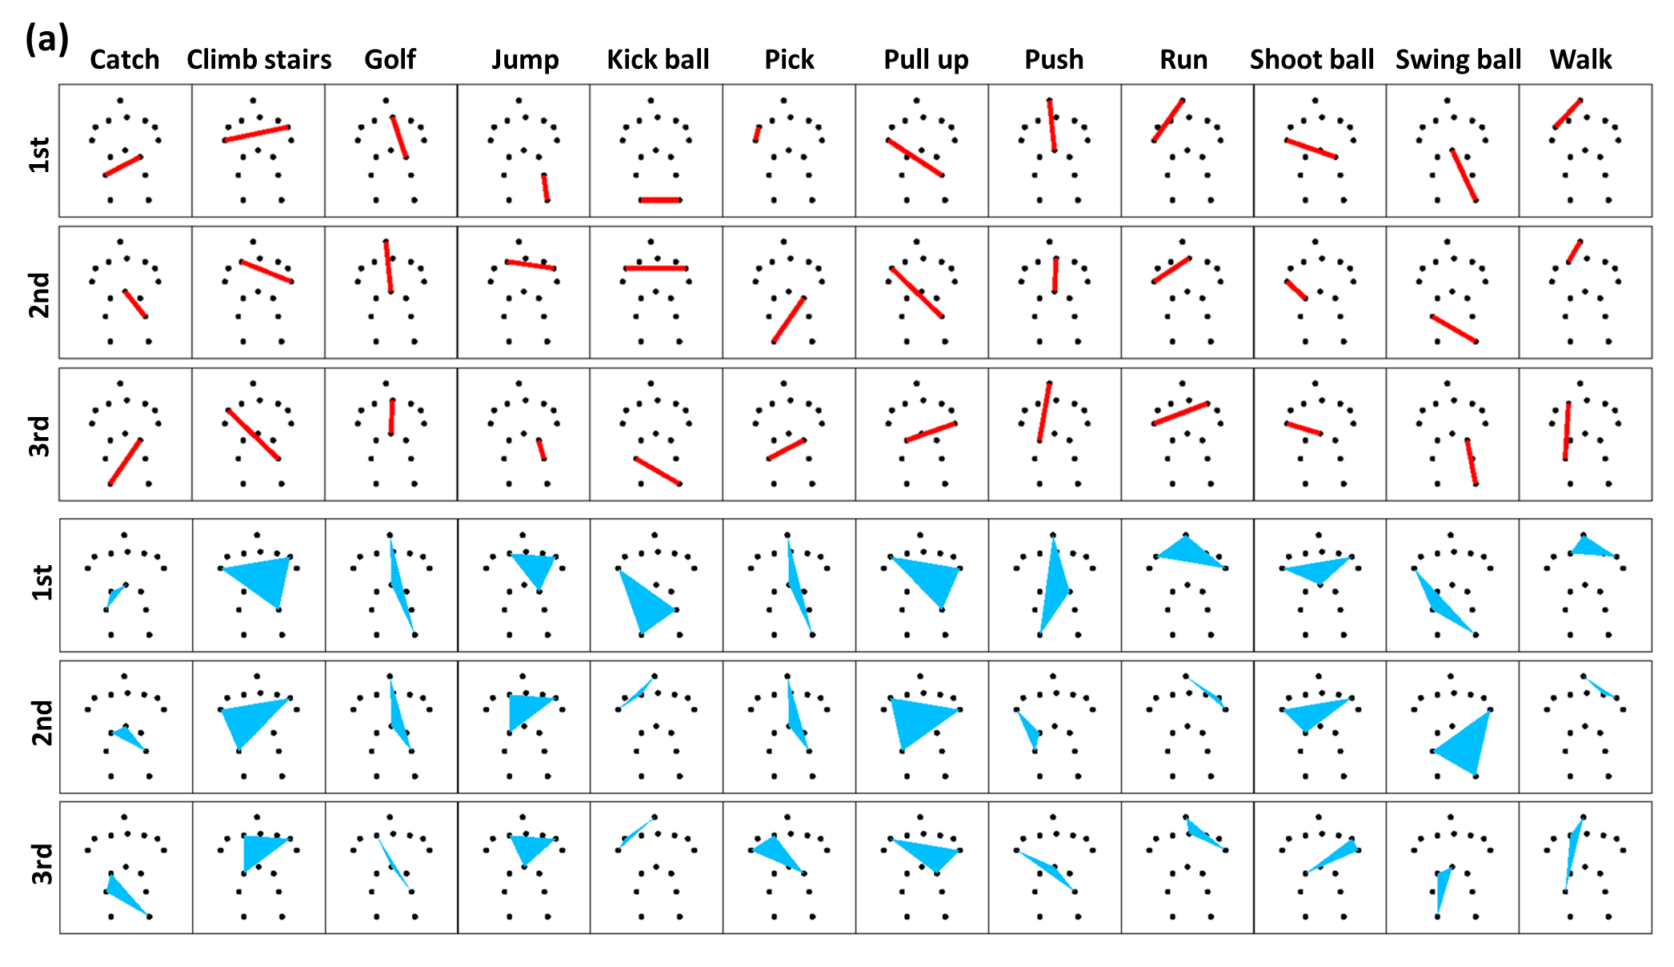
Toward understanding action recognition
For Spatial Structure：
Top-3 most “important” Pairs/Triples on sub-JHMDB dataset

Slide 26
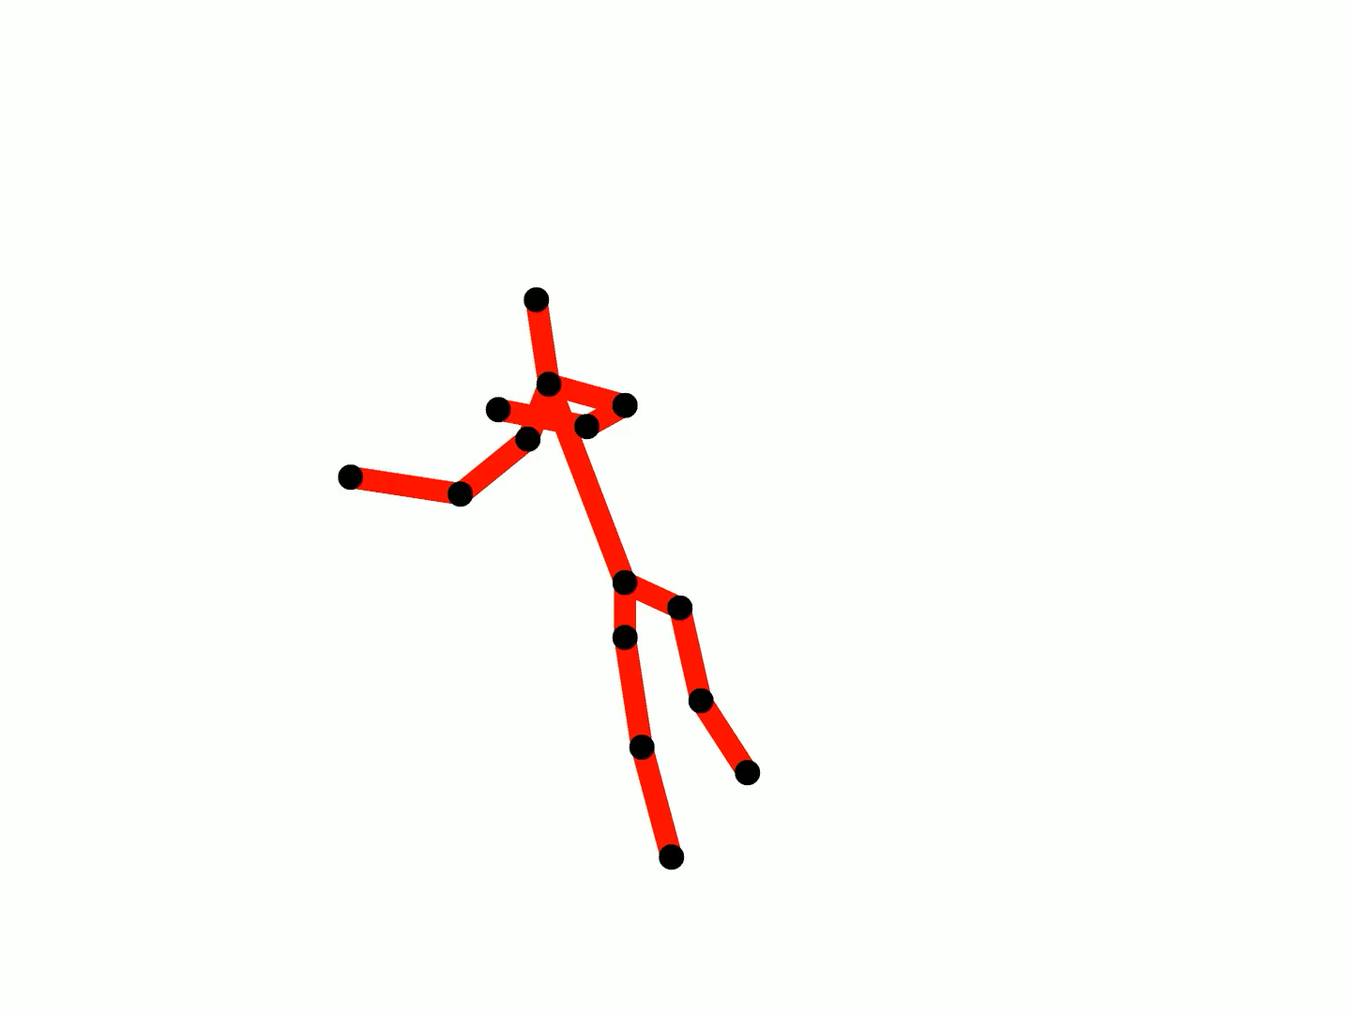
Can you guess?

Slide 27
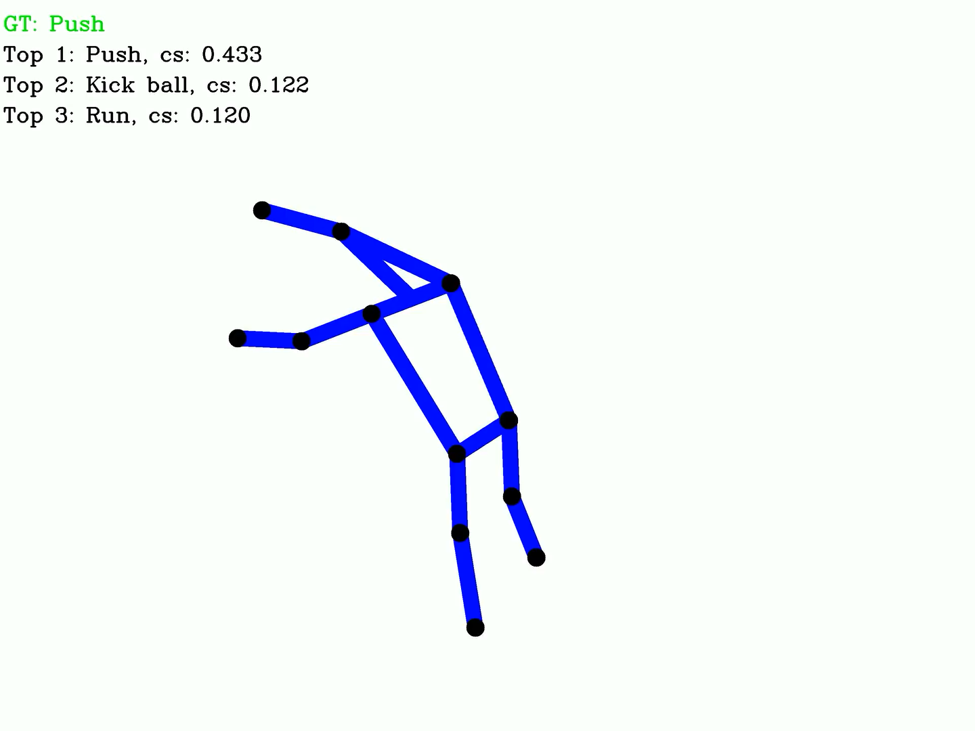

PUSH

Slide 28
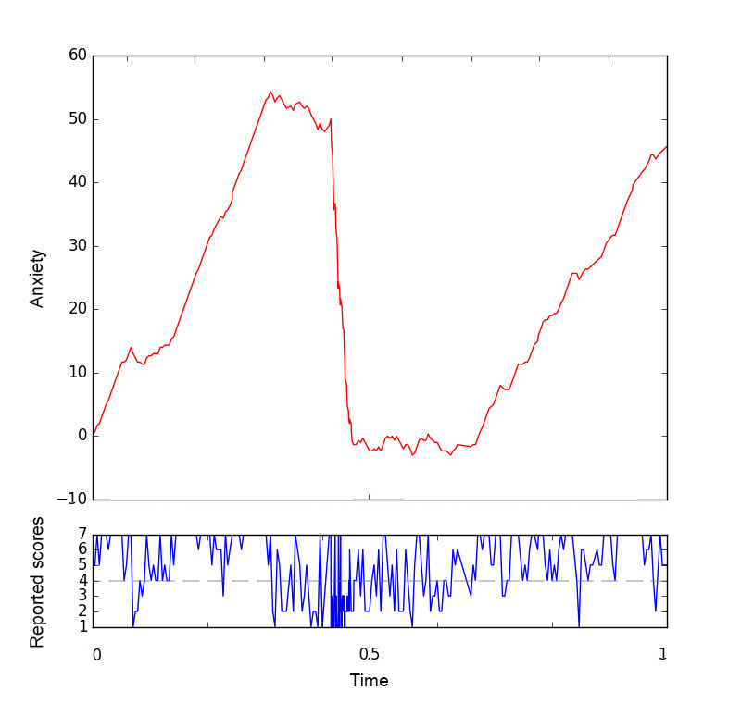
Triaging BP BP & N on the basis of mood zoom
  In a clinical trial, mood zoom data was requested daily from three groups (total 130 people for a year) with distinct diagnoses: bipolar disorder, borderline personality disorder or healthy control. The data was noisy, missing.
  This mood data was grouped into episodes of 20 sequential responses; a random forest classifier using second order signature features was trained on these episodes; it obtained very good separation of the three groups using one-cross validation.
  Second order information was important. Signatures were critical to controlling the dimension given the sample size.
  Arribas, Imanol Perez, Guy M. Goodwin, John R. Geddes, Terry Lyons, and Kate EA Saunders. "A signature-based machine learning model for distinguishing bipolar disorder and borderline personality disorder." Translational psychiatry 8, no. 1 (2018): 274.
Evolution of anxiety scores for a participant
diagnosed with bipolar disorder.

Slide 29
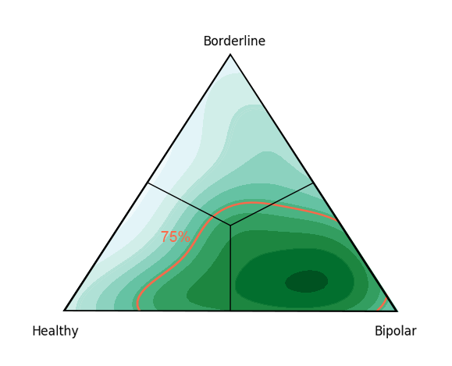
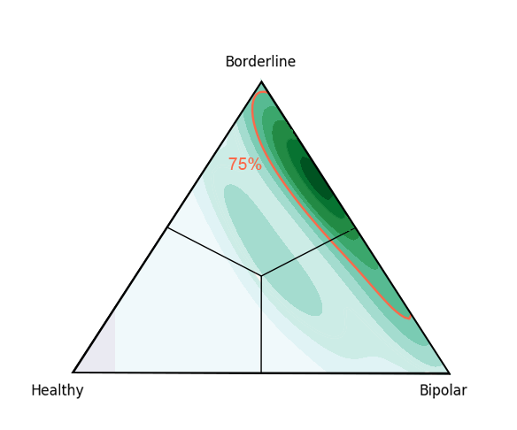
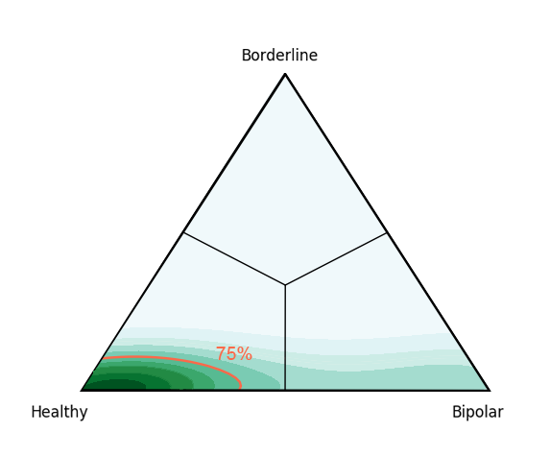
Triaging BP BP & N on the basis of mood zoom
  Mood zoom data was requested daily from three groups (total 130 people for a year) with distinct diagnoses: bipolar disorder, borderline personality disorder or healthy control. The data was noisy, missing. Using higher order information (anger before depression …) captured by low dimensional signatures was able to classify on spectrum. The project is one of three being showcased and made reproducible at the ATI.

Slide 30
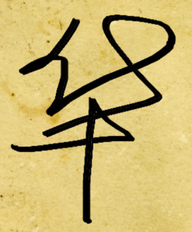
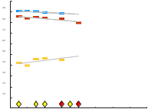

Leveraging the mathematics
Chinese handwriting
Finger drawn characters
Action Recognition
Moving matchstick man
Alzheimer’s Disease
Brain Weights
Complex social data
Evolving mood

Slide 31
Leveraging the mathematics
arXiv:2006.05805 cs.LG stat.ML Distribution Regression for Continuous-Time Processes via the Expected Signature, Maud Lemercier, Cristopher Salvi, Theodoros Damoulas, Edwin V. Bonilla, Terry Lyons | A learning framework to infer macroscopic properties of an evolving system from longitudinal trajectories of its components.
arXiv:2006.03487 cs.LG stat.ML Anomaly detection on streamed data, Thomas Cochrane, Peter Foster, Terry Lyons, Imanol Perez Arribas | A simple methodology for identifying anomalous observations against a corpus of `normal' observations. The observations are streams.
arXiv:2006.00873 cs.LG stat.ML, A Generalised Signature Method for Time Series, James Morrill, Adeline Fermanian, Patrick Kidger, Terry Lyons | A broadband generalised signature method
arXiv:2005.13948 cs.LG stat.ML, Generalised Interpretable Shapelets for Irregular Time Series, Patrick Kidger, James Morrill, Terry Lyons | Extending the shapelet transform.
arXiv:2005.08926 cs.LG stat.ML, Neural Controlled Differential Equations for Irregular Time Series, Patrick Kidger, James Morrill, James Foster, Terry Lyons | Neural controlled differential equations
arXiv:2001.00706 cs.LG stat.ML Signatory: differentiable computations of the signature and logsignature transforms, on both CPU and GPU, Patrick Kidger, Terry Lyons | Signatory is a library for calculating signature and logsignature transforms and related functionality.
arXiv:1908.08286 cs.LG stat.ML, Learning stochastic differential equations using RNN with log signature features, Shujian Liao, Terry Lyons, Weixin Yang, Hao Ni | Learning a function on streamed multimodal data through evaluation.
arXiv:1907.08423 math.PR math.NA, Insertion algorithm for inverting the signature of a path, Jiawei Chang, Terry Lyons | The insertion method for reconstructing the path from its signature.
arXiv:1905.08494 cs.LG stat.ML, Deep Signature Transforms, Patric Bonnier, Patrick Kidger, Imanol Perez Arribas, Cristopher Salvi, Terry Lyons | Combines the advantages of the signature transform with modern deep learning frameworks.

Slide 32
Thank you

